Slide 1


Alliance School of Advanced Computing
Mini Project Title: Mobile Penetration Test Report Generator with CVSS 3.1 Calculator
Course: Mobile Penetration Testing & Ethical Hacking
Course code: 7CS1292
Team Members:
Bachireddy Alekhya — 2023BCSE07AED083
Tejashwini R — 2023BCSE07AED208
Srinivas R — 2023LCSE07AED659
Faculty: Dr. Durgadevi

Slide 2

02- Problem Statement & Objectives
Problem Statement
Penetration-testing reports require vulnerability details, CVSS scores, evidence and remediation information. Managing these manually can be time-consuming and inconsistent.
Why is it important?
A single platform can reduce repetitive documentation work and maintain consistent vulnerability scoring and report formatting.
Objectives
Develop a simple web-based reporting platform.
Integrate CVSS 3.1 scoring with severity feedback.
Support evidence attachment for findings.
Generate structured PDF security reports.

Slide 3
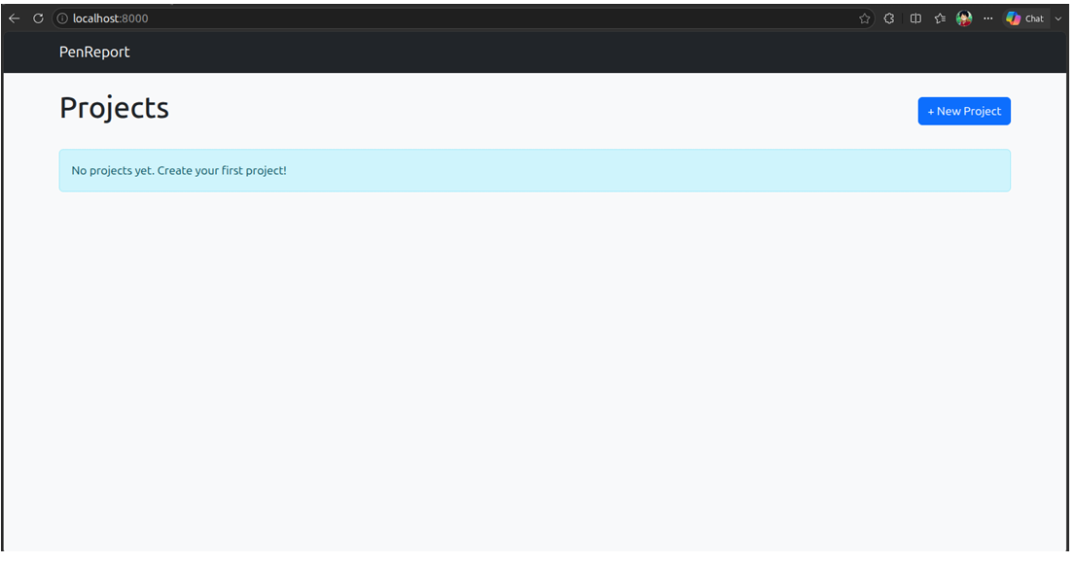
Dashboard

Slide 4
03- REQUIREMENTS
Functional Requirements
The system allows the tester to create projects, manage findings, calculate CVSS scores, upload evidence and generate reports.
Project & finding management
CVSS 3.1 calculation
Evidence upload
PDF report generation
Non-Functional Requirements
The application should be simple, consistent and suitable for local use.
User-friendly interface
Consistent scoring
Local operation
Readable report output
Hardware: Dual-core CPU, 2 GB+ RAM, ~100 MB storage
Software: Python 3.10+, FastAPI, SQLite, Chrome/Firefox/Edge

Slide 5
04- PROPOSED SOLUTION
PenReport
PenReport is a web-based penetration-testing report management system that combines vulnerability documentation, CVSS scoring, evidence management and automated PDF generation in one platform.
Key Features
Project Management → Create and manage testing projects
Finding Management → Record vulnerability and remediation details
CVSS Calculator → Calculate score and severity
Evidence Management → Attach supporting screenshots
PDF Generation → Create structured security reports
Advantage
Instead of managing findings, scoring, evidence and reporting separately, PenReport provides them through one integrated workflow.
Project → Finding → CVSS → Evidence → PDF

Slide 6
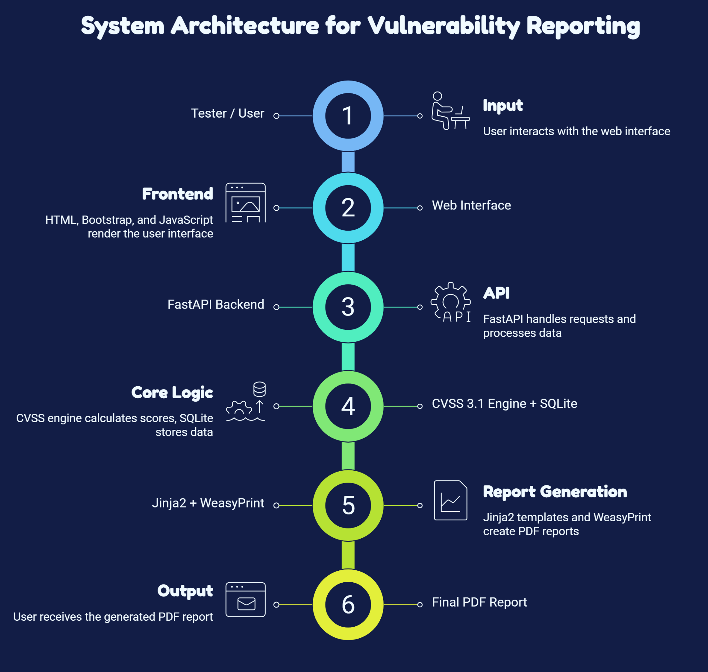
05- ARCHITECTURE / WORKFLOW

Slide 7
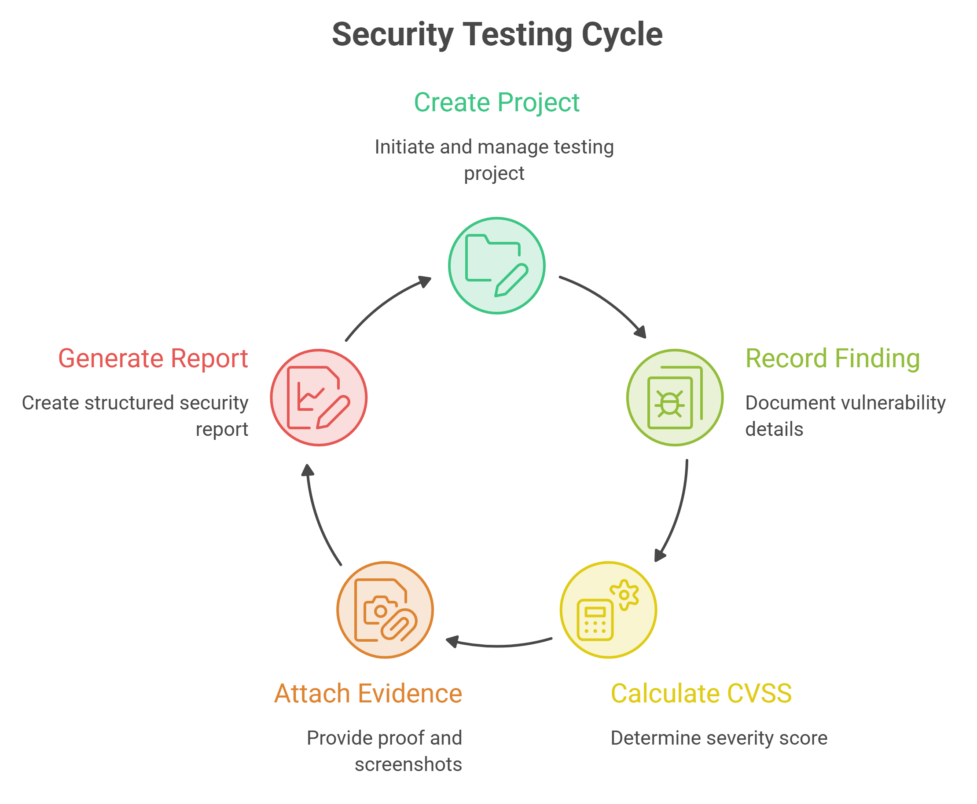
05- ARCHITECTURE / WORKFLOW
Major Components
Frontend: User interaction
FastAPI: Application logic
CVSS Engine: Score & severity calculation
SQLite: Stores project and finding data
WeasyPrint: Converts report to PDF

Slide 8
06- TECHNOLOGIES & IMPLEMENTATION
Category | Technologies
Language | Python
Backend | FastAPI, Uvicorn
Database | SQLite, SQLAlchemy
Frontend | HTML, CSS, Bootstrap 5, JavaScript
Reporting | Jinja2, WeasyPrint
Security | CVSS 3.1
Implementation
The system follows a simple pipeline:
Project Creation → Finding Management → CVSS Calculation → Database Storage → Evidence → PDF Generation → Testing

Slide 9
07- RESULTS & APPLICATIONS
Results
The prototype was tested for its major functions and the recorded tests passed successfully.
Project Creation | Finding Management | CVSS Scoring | Evidence Upload | PDF Generation
Applications
Penetration-testing reporting
Mobile application security testing
Vulnerability assessment
Security audit documentation
Challenges & Solutions
Challenge | Solution
CVSS calculation | Integrated CVSS 3.1 calculator
Evidence management | Finding-based screenshot upload
Report formatting | Automated PDF generation

Slide 10
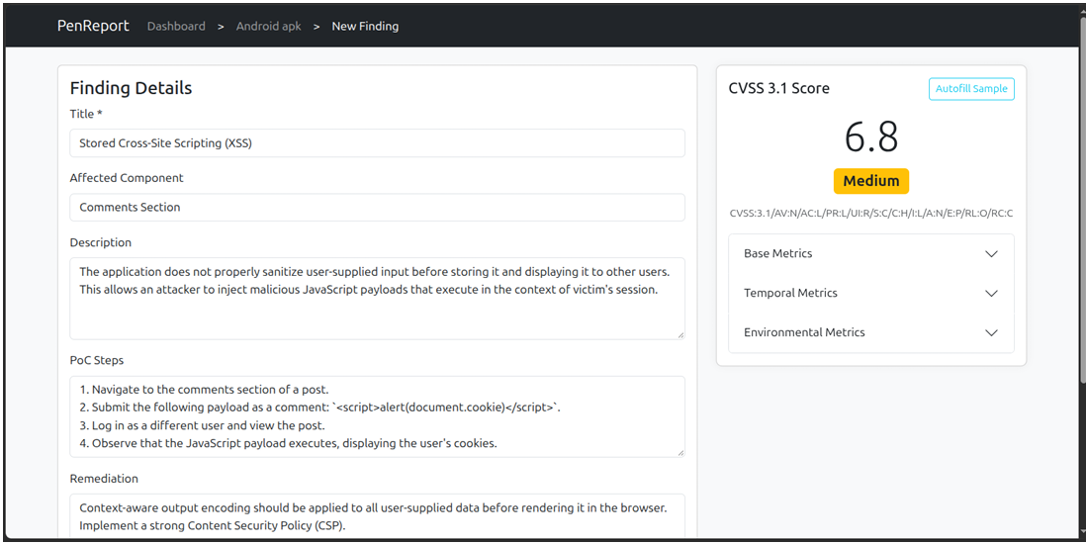
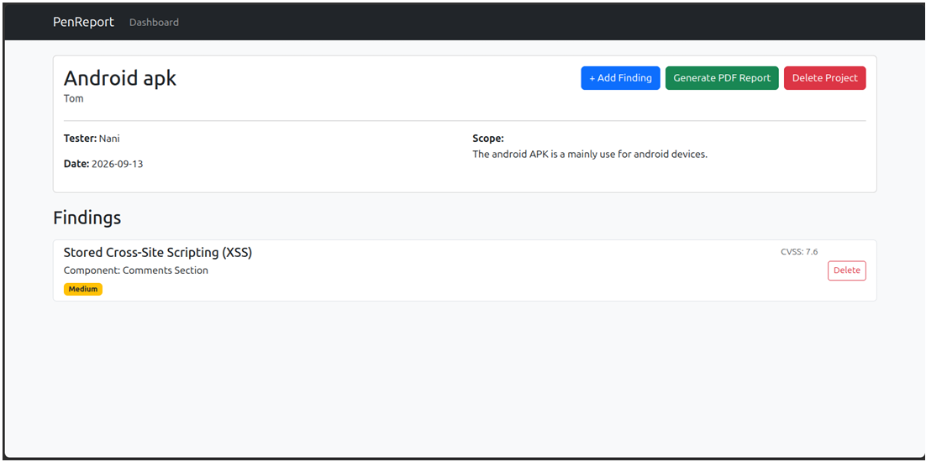
07- RESULTS & APPLICATIONS

Slide 11
08- CONCLUSION & FUTURE SCOPE
Conclusion
PenReport provides a simple and organized way to document vulnerabilities, calculate CVSS 3.1 scores, manage evidence and generate structured PDF reports.
Key Outcomes
Reduced manual reporting effort
Consistent vulnerability scoring
Organized evidence and findings
Automated report generation
Future Scope
User authentication
JSON/CSV report formats
Vulnerability dashboards
CVSS 4.0 support
Cloud & multi-user deployment
Docker deployment

Slide 12
09- References
1. Penetration Frameworks and Development Issues in Secure Mobile Application Development: A Systematic Literature Review
IEEE Access, 2021
Note: Explains common frameworks and techniques used for mobile application penetration testing.
Link: IEEE / DOI
2. Dynamic Security Analysis on Android: A Systematic Literature Review
IEEE Access, 2024
Note: Reviews techniques used to identify security vulnerabilities in Android applications. Orbilu
Link: IEEE / DOI
3. Static Analysis of Android Apps: A Systematic Literature Review
Information and Software Technology, Elsevier, 2017
Note: Explains how static analysis can be used to detect security and privacy issues in Android apps. ScienceDirect
Link: ScienceDirect / DOI
4. Common Vulnerability Scoring System
IEEE Security & Privacy, 2006
Note: Introduces CVSS as a standard method for measuring vulnerability severity. NIST
Link: NIST / Paper
5. Can the Common Vulnerability Scoring System be Trusted? A Bayesian Analysis
IEEE Transactions on Dependable and Secure Computing, 2018
Note: Studies the reliability and consistency of CVSS vulnerability scores. IEEE Xplore
Link: IEEE Xplore / Paper

Slide 13













Department of Computer Science and Engineering Alliance School of Advanced Computing
THANK YOU
©ASAC – Alliance University, 2026. All rights reserved. Unauthorized reproduction or distribution is prohibited.

